Slide 1


Network Security Analysis
Detecting Cyber Threats Automatically

Slide 2

CONTENT
01
02
Network Security Analysis
Data Exploration Insights
03
Machine Learning Results

Slide 3


01
Network Security Analysis

Slide 4

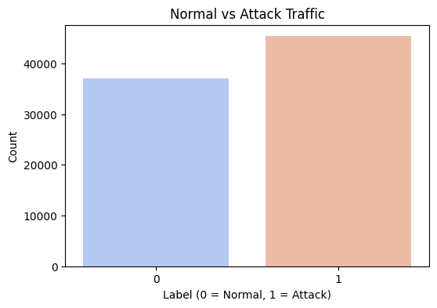
Normal vs Attack Traffic
Traffic Distribution Analysis
Detection Implications
Significant imbalance between normal network connections and attack traffic detected in the dataset.
Imbalanced distribution affects security monitoring strategies and requires specialized detection approaches for comprehensive protection.
Attack Prevalence
Traffic Pattern Recognition
Visual representation shows attack traffic comprises substantial portion of network activity requiring immediate attention.
Understanding normal vs attack patterns helps establish baseline behavior for more effective anomaly detection.

Slide 6







Attack Categories Distribution
Attack Types Overview
Attack vs Normal Traffic
Analysis reveals diverse attack categories in network traffic data.
Visual comparison shows proportion of malicious versus legitimate network connections.
01
02
03
04
Most Common Attacks
Security Implications
Generic, Exploits and DoS attacks appear most frequently in the dataset.
Understanding attack distribution helps prioritize defense mechanisms and resource allocation.

Slide 7
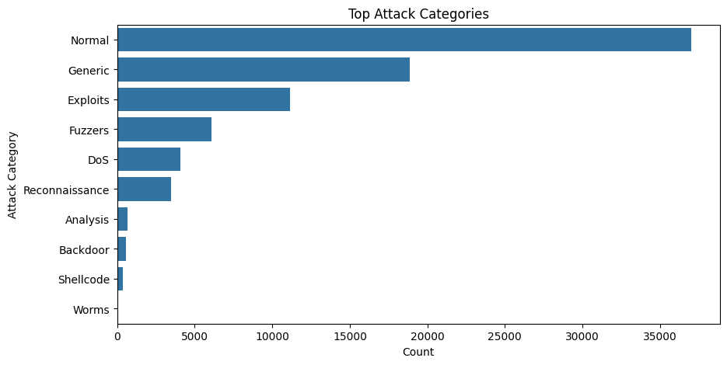

Slide 8




Protocol Usage Patterns
Analysis reveals most frequently used network protocols, displayed in descending order for better visibility.
Chart shows varying usage patterns across different protocols, with some clearly dominating network traffic.
Top 15 Protocols
Protocol Distribution
Protocol preferences may indicate normal operations or potential security concerns requiring further investigation.
Understanding protocol distribution helps identify unusual patterns that could signal network intrusions.
Security Implications
Traffic Analysis

Slide 9
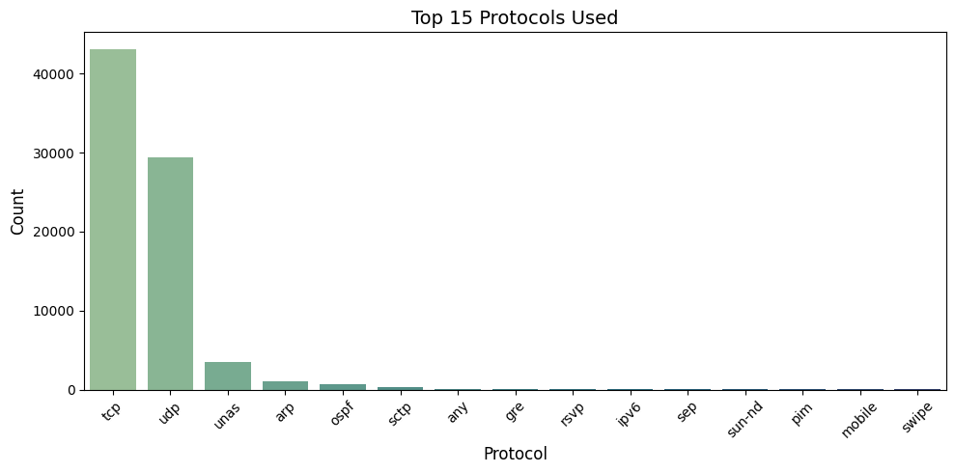

Slide 10
02
Data Exploration Insights

Slide 11
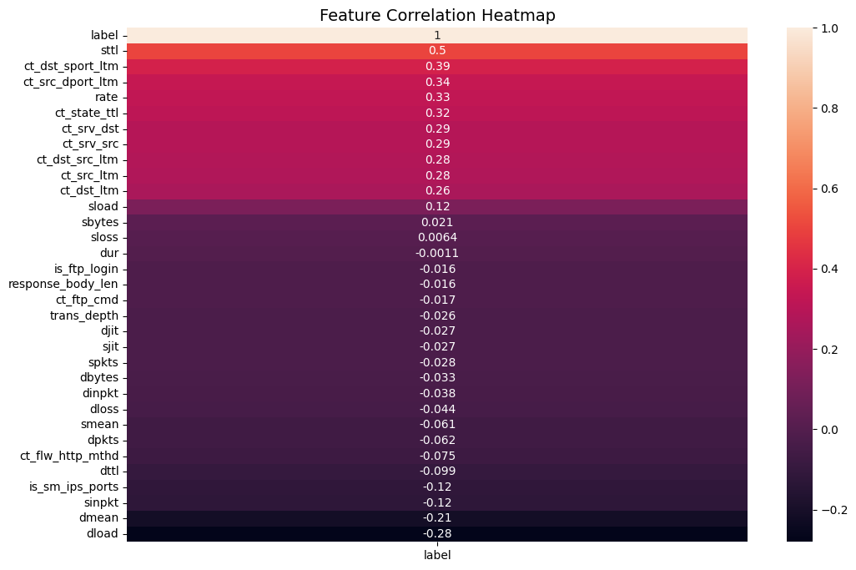
Key Statistical Findings
Normal vs Attack Traffic
Feature Correlation
Dataset shows significant imbalance between normal connections and attack instances across network traffic.
Strong relationships exist between specific network attributes and attack detection, guiding security focus areas.
Top Attack Categories
Protocol Distribution
Analysis reveals several attack types with varying frequencies, highlighting common network threats.
Certain protocols appear more frequently, potentially indicating preferred channels for network communication.

Slide 12
Feature Correlations
Correlation with Attack Labels
Redundancy Detection
Numerical features show varying relationships with attack detection, helping identify key predictive variables.
High correlation between features indicates potential data redundancy that can be eliminated for model efficiency.
Predictive Power Analysis
Heatmap Visualization
Strong correlations with target labels reveal which network metrics best detect suspicious activity.
Color-coded matrix displays correlation strength, highlighting most significant features for security monitoring.

Slide 14


Traffic Pattern Anomalies
Normal vs Attack Traffic
Attack Categories
Dataset shows significant imbalance between normal connections and attack traffic, highlighting security monitoring challenges.
One
Multiple attack types identified, with certain categories appearing more frequently in network traffic analysis.
Two
Protocol Distribution
Three
Traffic Anomaly Indicators
Analysis reveals which protocols attackers target most frequently, helping prioritize security monitoring efforts.
Specific network behaviors and patterns serve as key indicators when identifying potential security threats.
Four

Slide 15
03
Machine Learning Results

Slide 16

Model Performance Metrics
Confusion Matrix
Classification Accuracy
Visual representation shows correct vs incorrect predictions, highlighting model's strong performance.
Model achieved high detection rates for network attacks with minimal false positives.
3
4
Feature Importance
Detection Strengths
2
1
Top 15 features identified as most critical for accurate attack detection.
Model excels at identifying specific attack categories while maintaining overall accuracy.

Slide 17
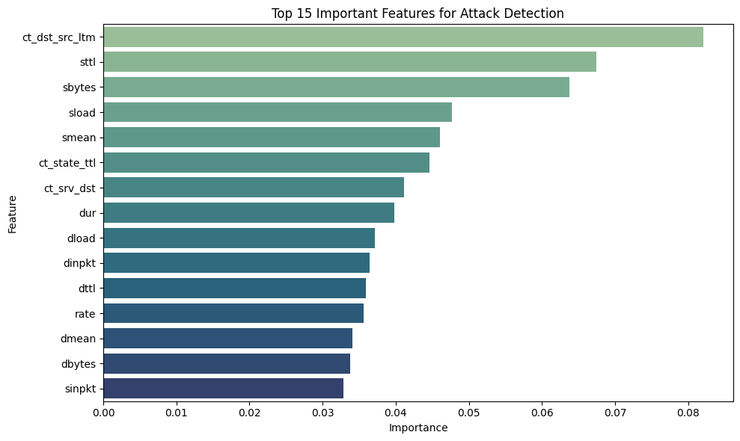

Slide 18


Confusion Matrix Analysis
Model Performance Visualization
Visual representation of prediction accuracy showing true positives, false positives, true negatives and false negatives.
01
Detection Accuracy
Confusion matrix reveals high accuracy in classifying normal traffic and attack patterns.
02
Error Analysis
Identifies misclassifications where normal traffic was flagged as attacks or attacks went undetected.
03
Security Implications
False negatives represent security risks while false positives may cause operational disruptions.
04

Slide 19
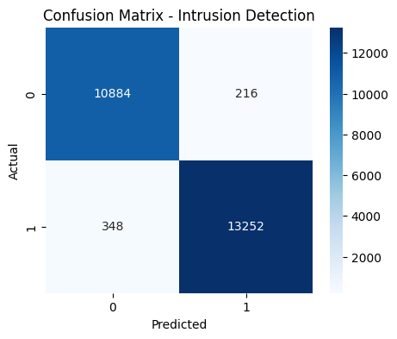

Slide 20




Top Predictive Features
1
2
3
4
Feature Importance Analysis
Top 15 Features
Practical Applications
Technical Significance
Key network attributes that best predict cyber attacks, identified through machine learning.
Random Forest algorithm revealed most significant indicators for detecting malicious network traffic.
These features enable efficient threat detection and prioritization of security monitoring efforts.
Understanding these indicators helps security teams focus resources on most relevant network attributes.

Slide 21

Thanks！

